Slide 1
UNSUPERVISED LEARNING

Slide 2
K-means cluster
"K-means clustering is a method used in unsupervised machine learning to partition a dataset into K clusters based on similarity in the data points' features.
It aims to minimize the variance within each cluster, assigning each data point to the cluster whose mean is nearest."

Slide 3
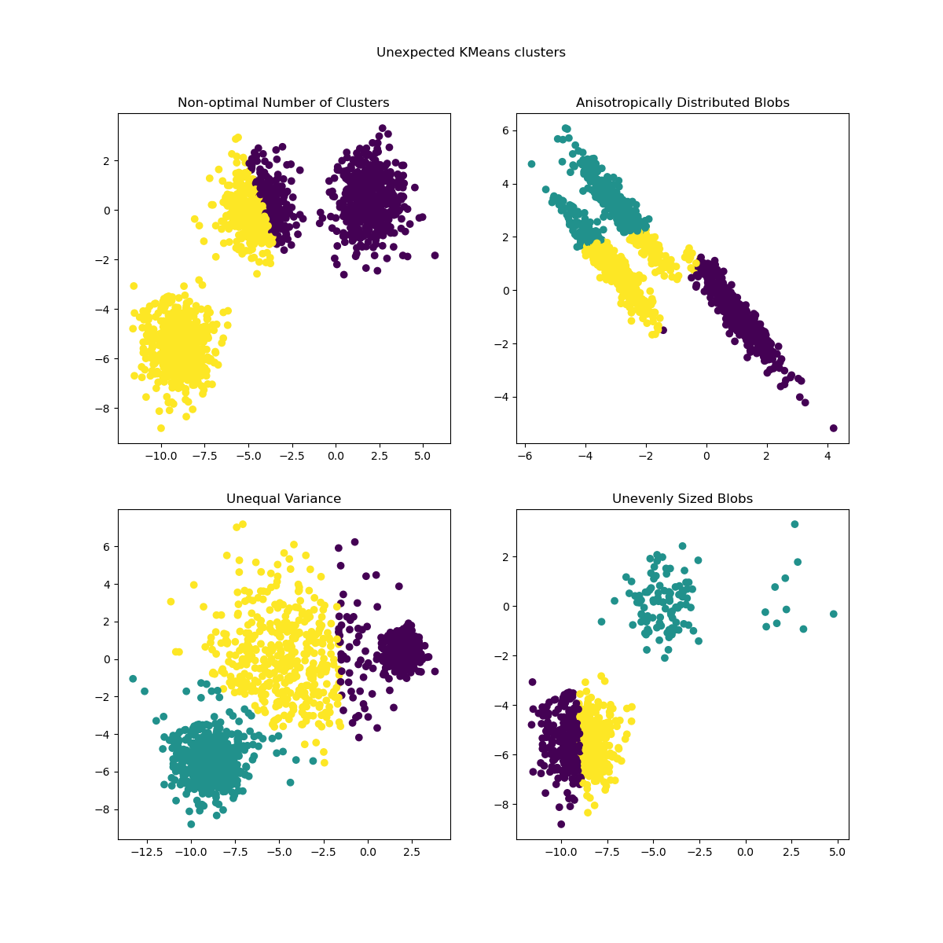

Slide 4
Principle:
Image Segmentation: To partition images into distinct regions based on pixel values.
Customer Segmentation: To group customers based on purchasing behavior, demographics, etc., for targeted marketing strategies.
Anomaly Detection: Identifying outliers or anomalies in data that do not fit into any cluster.
Document Clustering: Grouping documents based on similarity in their content.
Genetic Data Analysis: Clustering genes with similar expression patterns across samples.

Slide 5
Advantages:
Simplicity: K-means is easy to understand and implement, making it one of the simplest clustering algorithms.
Efficiency: It is computationally efficient and works well with large datasets.
Scalability: K-means can handle large datasets with ease, making it suitable for big data applications.
Versatility: It can be applied to a wide range of data types and clustering tasks.
Interpretability: Results are relatively easy to interpret, especially when clusters are well-separated and have similar sizes.

Slide 6
Disadvantages:
Sensitivity to Initial Centroids: Results can vary depending on the initial placement of centroids, which can lead to suboptimal clustering.
Dependence on Number of Clusters (K): The number of clusters (K) needs to be specified in advance, and choosing an inappropriate K can lead to poor clustering results.
Sensitive to Outliers: K-means can be sensitive to outliers since it aims to minimize variance, which can lead to clusters being skewed towards outliers.
Assumes Spherical Clusters: It assumes that clusters are spherical and of similar size, which may not always reflect

Slide 7
Affinity Propagation
Affinity Propagation is a clustering algorithm that identifies exemplars (representative points) in a dataset based on similarity measures between pairs of data points.
It does not require the number of clusters to be specified in advance and aims to find the most representative points that best describe the data.

Slide 8
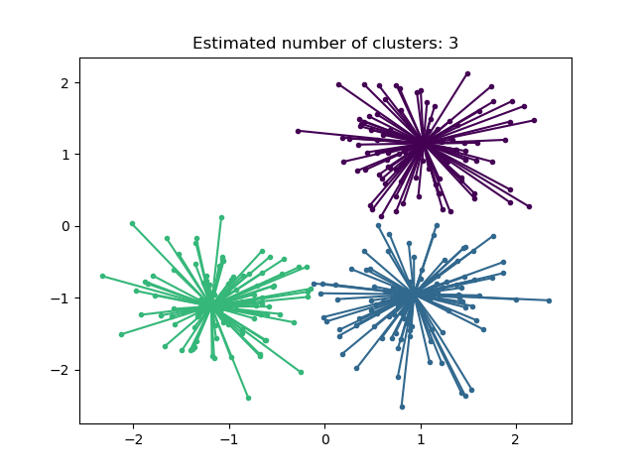

Slide 9
principle
Image Segmentation: Segmenting images into meaningful regions based on similarities between pixels or image patches.
Gene Expression Analysis: Clustering genes with similar expression patterns across samples to understand biological processes.
Natural Language Processing (NLP): Grouping documents or text data based on semantic similarity for tasks like document summarization or topic modeling.
Social Network Analysis: Identifying influential nodes or communities in social networks based on interaction patterns.
Market Basket Analysis: Identifying groups of products frequently purchased together by customers in retail settings.

Slide 10
Advantages:
Automatic Determination of Clusters: AP automatically determines the number of clusters based on the data, relieving the user from specifying the number of clusters (K) beforehand.
Robust to Noise and Outliers: It can handle noisy data and outliers well because it uses a similarity matrix that accounts for pairwise relationships rather than direct distances.
Identifies Exemplars: AP identifies exemplar points within clusters, which are representative of the entire cluster and useful for interpreting and summarizing cluster characteristics.
Suitable for Complex Data Structures: It can handle complex data structures and non-linear relationships between data points effectively.
Versatility in Applications: AP has been successfully applied in various domains, including image segmentation, gene expression analysis, social network analysis, and natural language processing.

Slide 11
Disadvantages:
Computational Complexity: AP is computationally expensive with a time complexity of O(N2T)O(N^2 T)O(N2T), where NNN is the number of data points and TTT is the number of iterations. This makes it less suitable for very large datasets.
Memory Intensive: It requires storing a similarity matrix of size N×NN \times NN×N, which can be memory intensive for large datasets.
Sensitive to Similarity Measure: The quality of clustering results can heavily depend on the choice of similarity measure used to construct the similarity matrix.
Difficulty in Interpreting Parameters: It may be challenging to interpret and adjust the damping factor and preferences parameter, which influence the clustering results.
Tendency for Overfitting: Affinity Propagation can sometimes lead to overfitting, especially if the data has a high degree of noise or if the number of clusters identified is not meaningful.

Slide 12
Mean Shift
Mean Shift is a clustering algorithm used in unsupervised machine learning to identify and group similar data points in a dataset.
It works by iteratively shifting points towards the mode (mean) of the data distribution until convergence, effectively finding clusters where data density is highest.

Slide 13
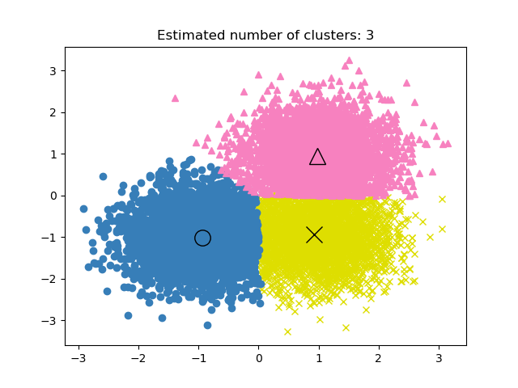

Slide 14
principle
Mean Shift clustering finds applications in various fields where identifying dense regions of data points is crucial. Some common uses include:
Image Segmentation: Segmenting images into regions based on color or texture similarity.
Object Tracking: Tracking objects in videos by identifying clusters of pixels representing the object of interest.
Feature Selection: Identifying relevant features in high-dimensional datasets by clustering similar features together.
Market Segmentation: Grouping customers or products based on similarities in purchasing behavior or characteristics.
Anomaly Detection: Identifying outliers or anomalies by clustering data points that deviate significantly from the main clusters.

Slide 15
Advantages:
No Assumption of Number of Clusters: Mean Shift does not require specifying the number of clusters KKK beforehand, making it suitable for cases where the number of clusters is unknown or variable.
Adaptive to Cluster Shapes: It can identify clusters of arbitrary shape and size, unlike methods that assume spherical clusters (like K-means).
Robust to Noise: Mean Shift is robust to noise in the data because it relies on data density estimation rather than distance metrics alone.
Automatic Cluster Center Detection: It automatically detects the number of clusters and their centers based on data density peaks, which simplifies the clustering process.
Parameter-Free in Many Cases: Mean Shift has fewer hyperparameters compared to other clustering algorithms, and in some cases, it can work effectively with default parameter settings.

Slide 16
Disadvantages:
Computationally Expensive: Mean Shift can be computationally expensive, especially for large datasets, due to its iterative nature and dependence on a bandwidth parameter that influences convergence.
Sensitive to Bandwidth Parameter: The performance of Mean Shift clustering heavily depends on the bandwidth parameter, which determines the size of the region used for density estimation. Choosing an appropriate bandwidth can be challenging and may require domain knowledge or experimentation.
Memory Intensive: It requires storing and updating a similarity matrix or density estimate, which can be memory intensive for large datasets.
Not Suitable for High-Dimensional Data: Like many clustering algorithms, Mean Shift can struggle with high-dimensional data due to the curse of dimensionality and the increased computational and memory requirements.
Convergence to Local Optima: Depending on the initial seed points and the choice of bandwidth, Mean Shift clustering can converge to local density peaks rather than the global optimum, affecting clustering quality.

Slide 17
Spectral clustering
Spectral clustering is a clustering technique that uses the eigenvalues (spectrum) of a similarity matrix to partition data points into clusters. It leverages the eigenvectors of the matrix to embed the data points into a lower-dimensional space where clustering is performed based on the distances between them. Spectral clustering is effective for identifying clusters with complex shapes and is widely used in various fields such as image segmentation, community detection in networks, and natural language processing.

Slide 18
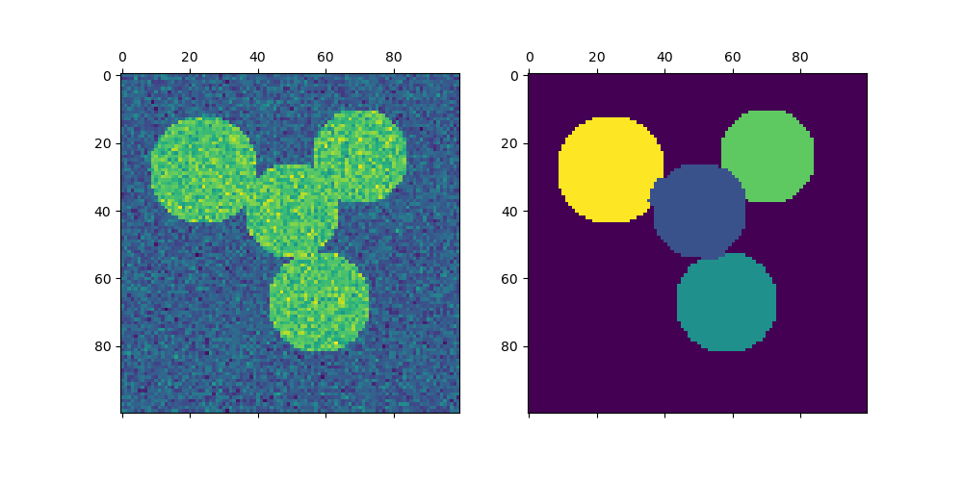

Slide 19
principle
Image Segmentation: Segmenting images into meaningful regions based on pixel intensity or texture similarity.
Document Clustering: Grouping text documents based on semantic similarity for tasks like topic modeling or document organization.
Biomedical Data Analysis: Clustering gene expression data to identify patterns related to disease or biological processes.
Social Network Analysis: Identifying communities or groups of nodes in social networks based on interaction patterns or similarities.
Dimensionality Reduction: Performing dimensionality reduction by clustering data points in a lower-dimensional space defined by the eigenvectors of the similarity matrix.
Graph Partitioning: Partitioning graphs into clusters based on the structure and connectivity of nodes.

Slide 20
Advantages:
Handles Complex Structures: Spectral clustering can identify clusters with complex shapes and structures that traditional clustering algorithms (like K-means) may struggle with.
Effective for Non-linear Data: It works well for datasets where the relationships between data points are non-linear, as it captures the affinity between points through a similarity matrix.
Not Sensitive to Cluster Shape: Unlike K-means, which assumes spherical clusters, Spectral clustering can handle clusters of arbitrary shapes.

Slide 21
Disadvantages:
Computationally Expensive: Spectral clustering involves computing the eigenvectors of the similarity matrix, which can be computationally expensive, especially for large datasets.
Memory Intensive: It requires storing and manipulating an n×nn \times nn×n similarity matrix (where nnn is the number of data points), which can be memory intensive for large datasets.
Difficulty with Scalability: As the size of the dataset grows, spectral clustering becomes less scalable compared to simpler methods like k-means.
Sensitivity to Parameter Tuning: Spectral clustering requires tuning parameters such as the number of nearest neighbors for constructing the similarity graph or the number of clusters, which can affect the quality of clustering results.
Interpretability of Results: Interpreting the meaning of clusters found by spectral clustering can be challenging, especially when dealing with high-dimensional data or complex similarity measures.

Slide 22
AgglomerativeClustering
Agglomerative clustering is a hierarchical clustering method where each data point starts as its own cluster, and pairs of clusters are iteratively merged based on their similarity until all clusters are combined into a single cluster or a desired number of clusters is reached.

Slide 23
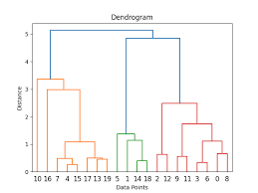

Slide 24
principle
Biology and Bioinformatics: Agglomerative clustering is used in biological data analysis to group genes with similar expression patterns across different conditions or to cluster biological samples based on their molecular profiles.
Image Segmentation: It can segment images by grouping pixels or regions with similar color, texture, or intensity values, allowing for the identification of distinct objects or regions within an image.
Document Clustering: In text mining and natural language processing, agglomerative clustering can group similar documents together based on their content or features, facilitating tasks like document categorization or topic extraction.

Slide 25
Advantages:
Hierarchical Structure: Agglomerative clustering produces a hierarchical clustering or dendrogram, which can provide insights into the relationships and hierarchy among clusters, making it easier to interpret the clustering results.
No Need for Prior Number of Clusters: Unlike k-means clustering, agglomerative clustering does not require specifying the number of clusters beforehand. Instead, it recursively merges clusters based on a similarity measure until a stopping criterion is met.
Handles Different Shapes and Sizes of Clusters: Agglomerative clustering can handle clusters of different shapes, sizes, and densities, making it suitable for datasets where clusters may have complex structures.
Flexibility in Distance Metrics: It allows flexibility in choosing distance metrics or similarity measures based on the nature of the data, which can be tailored to specific applications.
No Sensitivity to Initialization: Unlike k-means, which is sensitive to initial cluster centers, agglomerative clustering starts with each data point as its own cluster and merges based on similarity, reducing the impact of initialization on the final results.

Slide 26
Disadvantages:
Computational Complexity: Agglomerative clustering has a time complexity of O(n3)O(n^3)O(n3), where nnn is the number of data points. This makes it computationally expensive, especially for large datasets, due to the need to repeatedly compute pairwise distances or similarities.
Memory Intensive: It requires storing a distance or similarity matrix of size n×nn \times nn×n, which can be memory intensive for large datasets, limiting its scalability compared to more memory-efficient methods like k-means.
Difficulty with Large Datasets: Due to its computational and memory requirements, agglomerative clustering may become impractical for very large datasets with thousands or millions of data points.
Sensitive to Noise and Outliers: It can be sensitive to noise and outliers, as it tends to merge clusters based on proximity without considering the global structure of the data. Outliers can significantly affect the clustering results.

Slide 27
Hierarchy BisectingKMeans clustering
Hierarchy BisectingKMeans clustering is a hierarchical clustering algorithm that repeatedly partitions a dataset into two clusters using the k-means algorithm at each level of the hierarchy. This process creates a tree-like structure where each node represents a cluster, and the leaves represent individual data points or small clusters. It aims to find a hierarchical organization of the data that best fits the k-means clustering criteria at each step of the partitioning process.

Slide 28
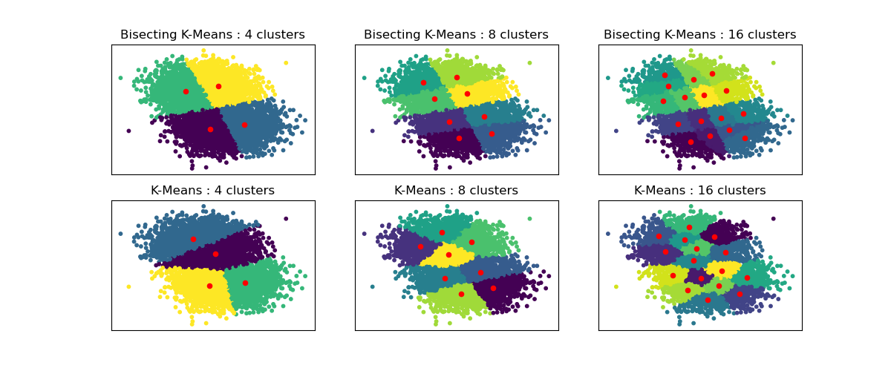

Slide 29
Principle
Document Clustering: It can be applied to group large collections of documents into clusters based on their content similarities. Hierarchical clustering allows for exploring topics at different levels of granularity.
Customer Segmentation: BisectingKMeans can segment customers based on their purchasing behavior or demographic data, enabling businesses to tailor marketing strategies and optimize customer engagement.
Image Segmentation: In image processing, it is used to segment images into regions with similar visual features, aiding tasks like object recognition and scene understanding.
Bioinformatics: It can cluster genomic data to identify patterns in gene expression or sequence similarity, helping in understanding genetic relationships and disease mechanisms.

Slide 30
Advantages:
Hierarchical Structure: BisectingKMeans clustering produces a hierarchical clustering structure, allowing for the exploration of clusters at different levels of granularity. This hierarchical representation can provide more insights into the data than flat clustering methods.
Flexibility in Cluster Shapes: Unlike traditional k-means clustering, which assumes spherical clusters, BisectingKMeans can handle clusters of arbitrary shapes and sizes due to its recursive partitioning approach.
Initialization Sensitivity: BisectingKMeans can be less sensitive to initialization than traditional k-means clustering, where the initial choice of cluster centroids can significantly affect the final clustering result.

Slide 31
Disadvantages:
Computational Complexity: BisectingKMeans clustering can be computationally expensive, especially for large datasets or when the number of clusters in the hierarchy is large. The algorithm needs to recursively apply k-means at each level of the hierarchy.
Fixed Number of Clusters: Unlike some hierarchical clustering methods that do not require specifying the number of clusters in advance, BisectingKMeans requires deciding on the number of clusters at each level of the hierarchy, which can be challenging.
Sensitive to Noise and Outliers: Like other partitioning clustering methods, BisectingKMeans clustering can be sensitive to noise and outliers, potentially leading to suboptimal cluster assignments if not properly handled.

Slide 32
HDBSCAN - Hierarchical Density-Based Spatial Clustering of Applications with Noise clustering
HDBSCAN (Hierarchical Density-Based Spatial Clustering of Applications with Noise) is a clustering algorithm that identifies clusters in data based on their density and hierarchical structure, while also handling noise points effectively.

Slide 33
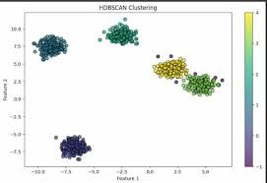

Slide 34
Principle
Anomaly Detection: HDBSCAN can effectively identify outliers or anomalies in datasets by classifying points with low density as noise, helping to clean and preprocess data.
Image Segmentation: It is used in computer vision to segment images by grouping pixels or regions based on their similarity in color, texture, or other features, thereby delineating objects or regions within an image.
Customer Segmentation: Businesses use HDBSCAN for market segmentation by clustering customers based on their purchasing behaviors, preferences, or demographic information, enabling targeted marketing strategies and personalized services.

Slide 35
Advantages:
Automatic Cluster Detection: HDBSCAN automatically determines the number of clusters in the data, making it suitable for datasets where the number of clusters is not known beforehand.
Handles Varying Density: It can identify clusters of varying shapes and sizes, as well as clusters embedded within clusters (hierarchical clusters), by considering the local density of points.
Robust to Noise: HDBSCAN is robust against noise points and outliers, classifying them as noise rather than forcing them into clusters, which improves the overall quality of clustering.
Parameter-Free or Minimal Parameters: It requires minimal tuning of parameters, such as the minimum cluster size or the neighborhood size, in contrast to many clustering algorithms that require setting the number of clusters explicitly.
Scalable: HDBSCAN is scalable to large datasets due to its use of efficient data structures and algorithms for density-based clustering.

Slide 36
Disadvantages:
Computational Complexity: HDBSCAN can be computationally intensive, especially for large datasets, due to the density calculations and the need to construct a minimum spanning tree or a mutual reachability graph.
Sensitive to Distance Metric: The performance of HDBSCAN can vary depending on the choice of distance metric used to measure proximity between data points. Some metrics may lead to suboptimal clustering results.
Interpretability of Results: While HDBSCAN produces clusters efficiently, interpreting the meaning of clusters in high-dimensional or complex datasets can be challenging, similar to other clustering algorithms.
Initial Memory Requirements: It requires sufficient memory to store distance matrices or neighborhood graphs, which may limit its application on very large datasets with millions of data points.

Slide 37
DBSCAN
DBSCAN (Density-Based Spatial Clustering of Applications with Noise) is a clustering algorithm that groups together closely packed points based on a density criterion, while marking points in sparse regions as noise.

Slide 38
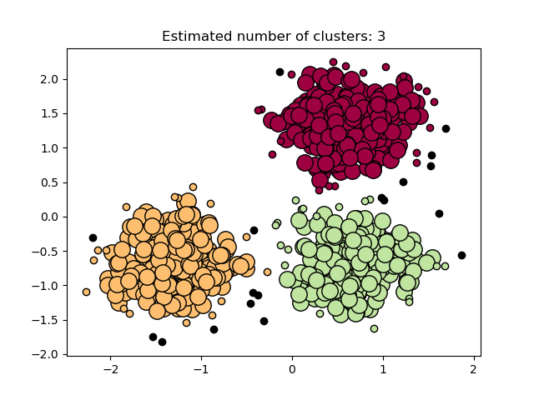

Slide 39
principle
Core Points: A core point is a point that has at least a specified number of points (MinPts) within a specified radius (eps).
Border Points: A border point is not a core point but lies within the eps-radius of a core point. Border points can be part of a cluster but do not expand the cluster further.
Noise Points: Noise points are points that do not meet the criteria to be either core or border points. They lie in low-density regions and are not part of any cluster.

Slide 40
Advantages:
Handles Arbitrary Shapes: DBSCAN can identify clusters of arbitrary shapes (non-linear boundaries), unlike traditional clustering algorithms like k-means, which assume convex shapes.
Robust to Noise: It is robust against noise and outliers in the data. Noise points are automatically labeled as such and not assigned to any cluster, improving the robustness of the clustering results.
Automatic Determination of Cluster Numbers: DBSCAN does not require the number of clusters to be specified beforehand. It determines clusters based on density parameters (eps and MinPts) and does not force every point into a cluster.
Efficient for Large Datasets: DBSCAN is efficient for large datasets. It uses spatial indexing structures like KD-trees to speed up the neighborhood search process, making it scalable.
Parameter Tuning: While DBSCAN requires setting parameters like eps (neighborhood radius) and MinPts (minimum number of points), these parameters can often be set based on domain knowledge or data characteristics, and the algorithm is not very sensitive to their exact values.

Slide 41
Disadvantages
Difficulty with Varying Density: DBSCAN may struggle with datasets where clusters have varying densities. If the density varies significantly across the dataset, choosing an appropriate eps value can be challenging.
Sensitivity to Distance Metric: The performance of DBSCAN can be sensitive to the choice of distance metric

Slide 42
OPTICS
Sure! OPTICS stands for "Ordering Points To Identify the Clustering Structure
." It's a data clustering algorithm used in data mining and machine learning to find clusters of varying density in spatial data.
The algorithm creates a reachability plot that helps visualize the clustering structure based on distance parameters.

Slide 43
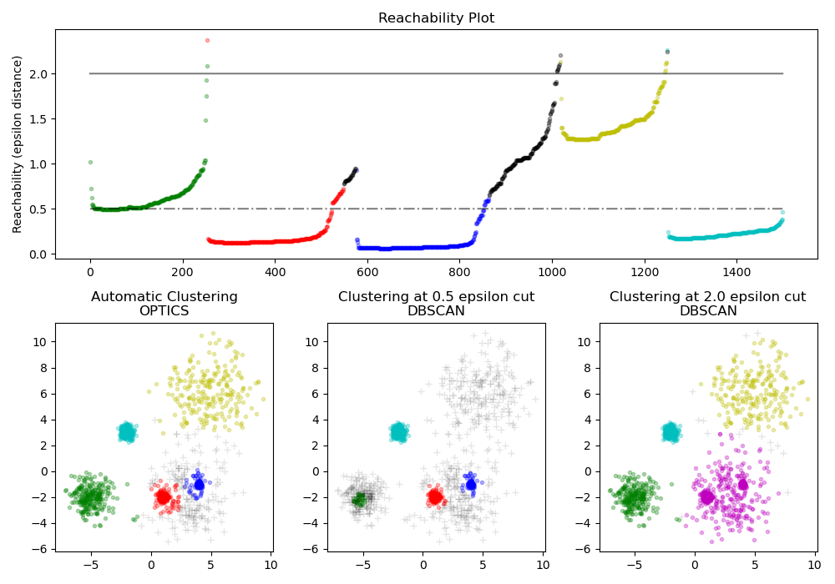

Slide 44
principle
Anomaly Detection: OPTICS can identify outliers or anomalies as points that are isolated or have low reachability distances, indicating they do not belong to any dense cluster.
Spatial Data Analysis: It is effective for clustering geographical data, such as identifying regions with different population densities, traffic patterns, or natural resource distributions.
Density-based Clustering: Unlike centroid-based methods like k-means, OPTICS is well-suited for clustering data where clusters have irregular shapes and varying densities.
Time Series Analysis: OPTICS can be adapted for clustering time series data by considering temporal sequences as spatial dimensions, helping to discover patterns or anomalies over time.

Slide 45
Advantages:
Handles Varying Density: OPTICS is effective in identifying clusters of varying densities, which traditional centroid-based methods like k-means struggle with.
No Need for Pre-specifying Number of Clusters: Unlike k-means, OPTICS does not require the number of clusters to be specified beforehand, making it more flexible and suitable for exploratory data analysis.
Robust to Noise and Outliers: The reachability distance concept in OPTICS helps in identifying outliers and noise as points with high reachability distances, thus making the clustering more robust in the presence of noisy data.
Hierarchical Clustering Structure: OPTICS produces a hierarchical clustering structure in the form of a reachability plot, which allows users to understand the clustering hierarchy and make informed decisions about cluster granularity.

Slide 46
Disadvantages:
Computational Complexity: OPTICS can be computationally intensive, especially for large datasets, because it involves calculating reachability distances between every pair of points.
Sensitive to Parameters: The performance of OPTICS can be sensitive to its parameters, such as the minimum points (MinPts) and epsilon (ε) distance threshold, which need to be carefully chosen based on the characteristics of the data.
Memory Intensive: It requires maintaining a reachability distance plot or a priority queue of points, which can consume significant memory, particularly for large datasets.
Difficulty in Interpreting Parameters: Unlike k-means where the number of clusters directly provides a clear interpretation, OPTICS parameters (MinPts, ε) can be less intuitive to interpret and tune correctly.

Slide 47
BIRCH
BIRCH clustering stands for "Balanced Iterative Reducing and Clustering using Hierarchies." It's a data clustering algorithm designed for handling large datasets by incrementally and hierarchically clustering data points into a tree structure. This allows for efficient clustering and summarization of complex data without needing to store all data points in memory simultaneously.

Slide 48
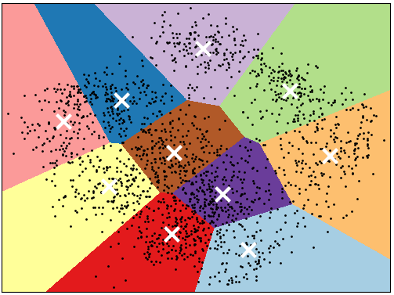

Slide 49
principle
Large-scale Data Mining: BIRCH clustering is particularly useful in scenarios where datasets are too large to fit into memory all at once. It efficiently processes data in a streaming manner, making it suitable for mining patterns and clusters in big data environments.
Web Mining: It can be applied to analyze web logs or user behavior data to identify clusters of users with similar browsing habits or access patterns, aiding in personalized recommendations or targeted advertising.
Image Segmentation: BIRCH clustering can be used to segment images into regions based on similar pixel characteristics, which is valuable in applications like object detection, medical imaging, or satellite image analysis.

Slide 50
Advantages:
Memory Efficiency: BIRCH clustering is designed to be memory-efficient, especially useful for handling large datasets. It uses a hierarchical clustering approach that summarizes data in a compact structure (CF tree), reducing the need to store all data points in memory simultaneously.
Scalability: It is scalable to large datasets and can handle high-dimensional data effectively. The CF tree structure allows for incremental updates and clustering, making it suitable for streaming data or dynamic datasets.
Fast Processing: BIRCH clustering is generally faster than traditional clustering algorithms like k-means for large datasets, as it avoids multiple scans of the entire dataset by maintaining summaries (CF entries) at different levels of the hierarchy.

Slide 51
Disadvantages:
Sensitive to Parameters: Like many clustering algorithms, BIRCH performance can be sensitive to its parameters, such as the maximum number of clusters (B) and the threshold for merging clusters (T), which need to be carefully tuned based on the dataset characteristics.
Limited Cluster Shapes: BIRCH assumes clusters to be roughly spherical due to its use of distance metrics and clustering criteria based on feature vectors. This may not be suitable for datasets with irregularly shaped clusters.
Difficulty Handling Different Densities: While BIRCH can handle varying densities to some extent, it may struggle with datasets containing clusters of significantly different densities or shapes, as it relies on a uniform criterion for merging clusters.

